Slide 1










A Gaming Site
Kapil Maheshwari (22300290140085)
Hritik Chaudhary (2300290140077)
Kavya Verma (2300290140087)
Prabal Pratap Singh(2300290140119)

Slide 2




Content
Abstract
Introduction
Literature Review
Objective Of The Project
Technology - (H/w And S/w Requirements)
Modules
Workflow
Reports
References

Slide 3




Abstract
The Game Site mini project is a web-based platform designed to offer users access to multiple games within a single site. The primary objective of the platform is to provide an engaging and interactive experience for players by offering a variety of games in one consolidated location. The site supports a seamless gaming experience by integrating different types of games, ranging from casual puzzles to more complex strategy games, all accessible through a user-friendly interface.

Slide 4




Introduction

Slide 5
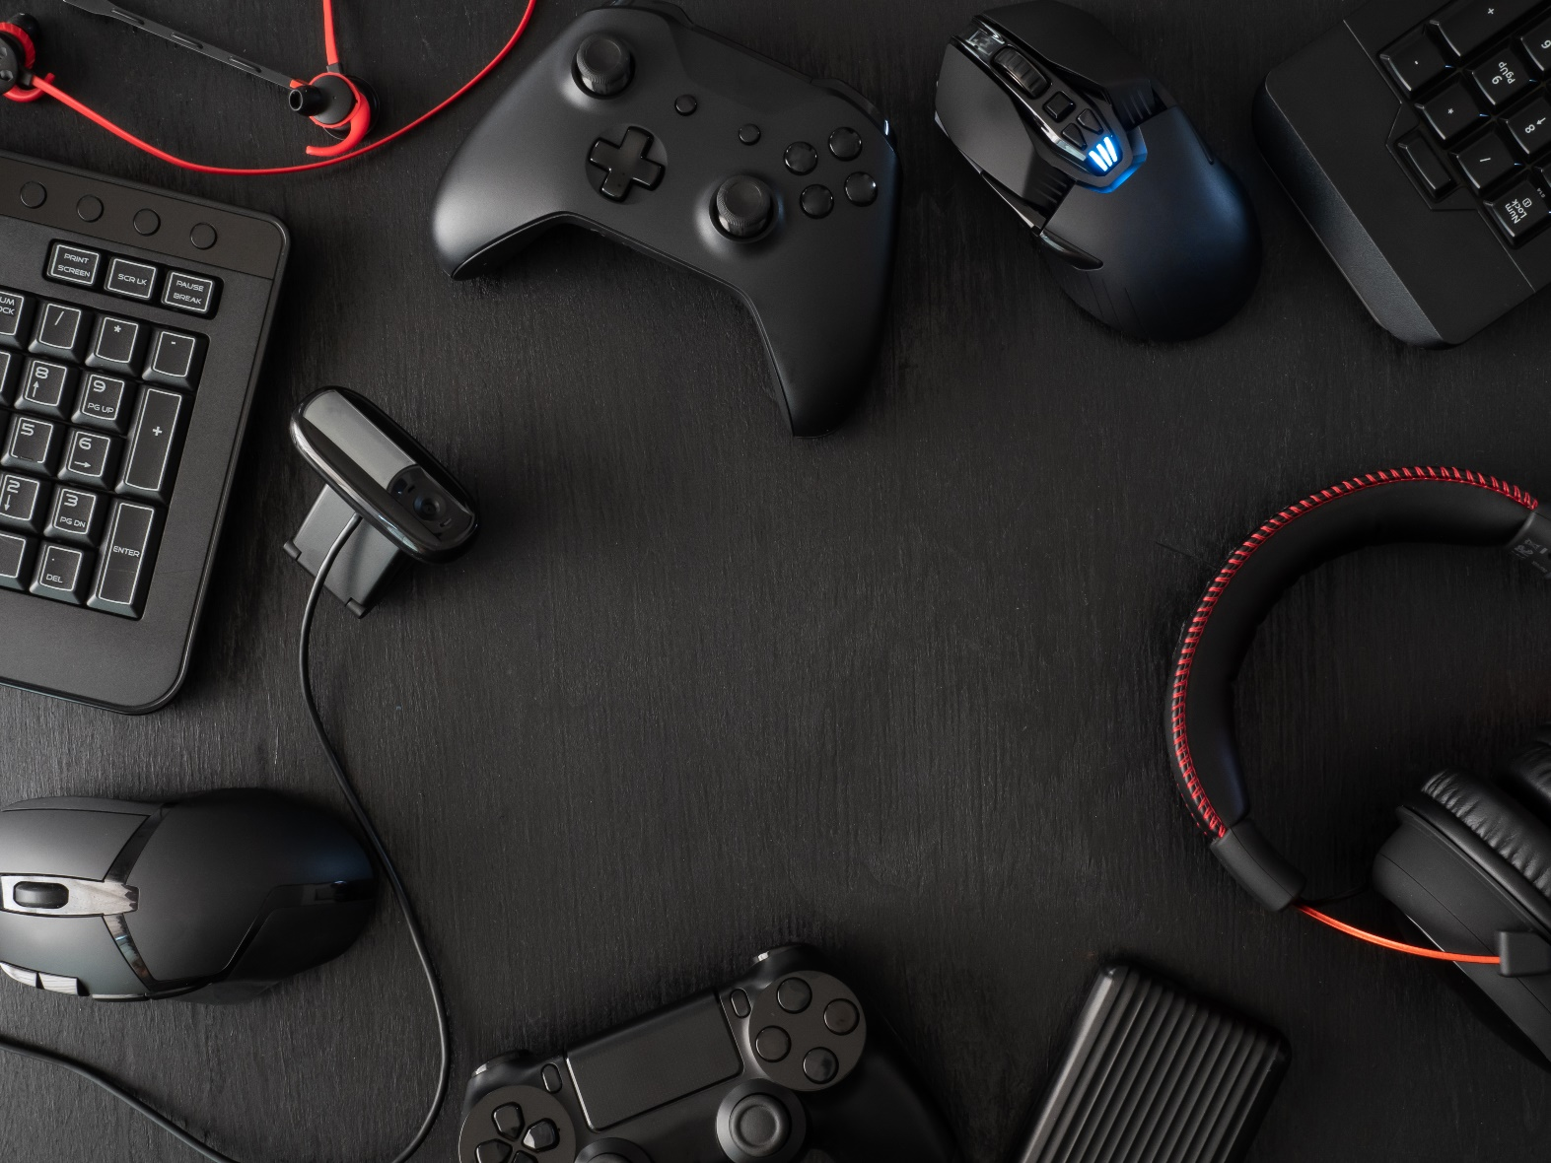
Online gaming is a major source of entertainment in today’s digital world.
The Game Site project addresses the need for a single
platform to access multiple games, from puzzles to
action-packed challenges.
Focus on ease of use: users can navigate between games
without visiting different websites or downloading apps.
Key features include:
Game selection menus
User login systems
Score tracking
Leaderboards
Scalability for adding new games
Built with modern web technologies for an engaging and personalized experience.

Slide 6
Literature Review

Slide 7
Evolution of Online Gaming
The growth of online gaming, especially Multiple-Online Games Platform (MOGP), started with "Multi-User Dungeons (MUDs)" in the 1970s. MOGs provide persistent virtual worlds where players interact, leading to the development of gaming culture and industries.
Player Type Theory
Bartle's Player Type Theory categorizes gamers into four types: Achievers, Explorers, Socializers, and Killers. This theory helps identify motivations behind player behavior, influencing game design and marketing strategies.

Slide 8
Whole Brain Thinking Model
The Whole Brain Thinking Model divides brain dominance into four quadrants: Analyzer, Organizer, Personalizer, and Visualizer. Applying this model in gaming can personalize in-game experiences and promotions, enhancing player engagement.
Game Industry Trends
The shift from "air time sales" to "item sales" in MMOGs has increased accessibility and revenue opportunities by offering free-to-play models with in-game item purchases. Personalized product offerings based on player preferences are gaining importance.
Impact of MOGs
MOGs affect player social interactions, time spent, and leadership skills in virtual environments. These games foster communities and require deeper engagement.

Slide 9


Objectives
1
2
3
4
1
2
3
4
Create a
Multi-Game
Platform
Ensure Cross-Device Compatibility
Provide a User-Friendly Interface
Integrate Gamification Features

Slide 10


Technology:
Hardware/ Software Requirements

Slide 11



Hardware Requiurements
Client-Side (User):
Processor: Intel i3 or higher
RAM: 4GB or more
Storage: 500MB+ for cache
Internet: 2 Mbps or faster
Display: 1280x720 resolution or higher
Server-Side (Hosting):
Processor: Multi-core (e.g., Intel Xeon)
RAM: 8GB+
Storage: 50GB SSD+
Bandwidth: 1TB/month or more
Uptime: 99.9% server uptime

Slide 12
Software Requiurements
Client-Side:
OS: Windows
Browser: Chrome (HTML5 compatible)
Server-Side:
OS: Linux (Ubuntu)
Languages: HTML, CSS, JS
Web Server: Node.js
Database: MongoDB
Version Control: Git

Slide 13
Modules

Slide 14
1. Game Catalog Module:
This module displays the available games on the platform. Users can browse through various game categories and select the ones they wish to play.
Features: Game Categories, Descriptions
2. Game Play Module:
The main module where the games are played. This includes game controls, instructions, and real-time progress tracking.
Features: Game Screen Interface, In-game Instructions, Score Tracking
3. Leaderboard:
This module displays leaderboards across different games, enhancing user engagement through competition.
Features: Game-Specific Leaderboards, Player Statistics

Slide 15



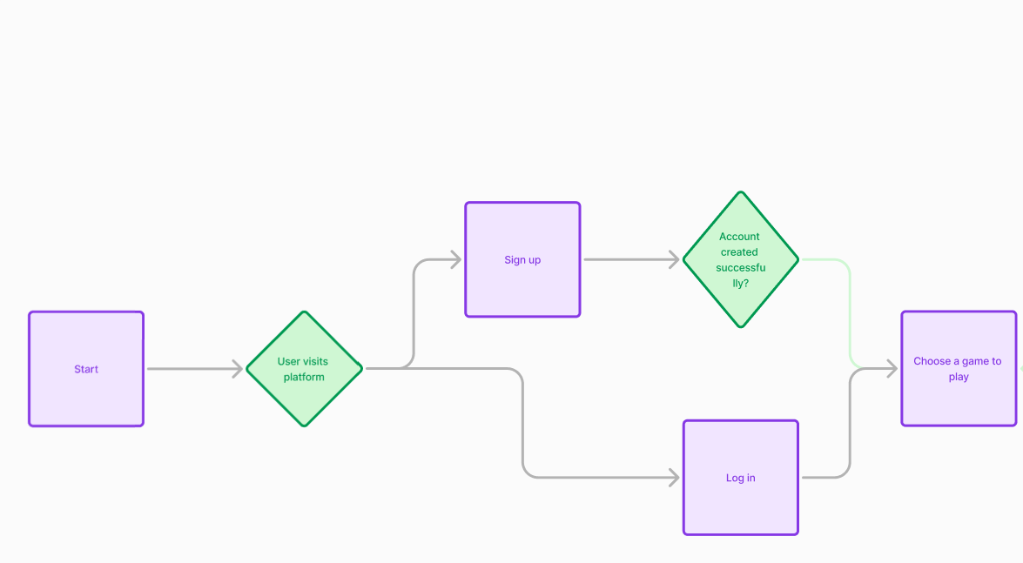


Workflow

Slide 16
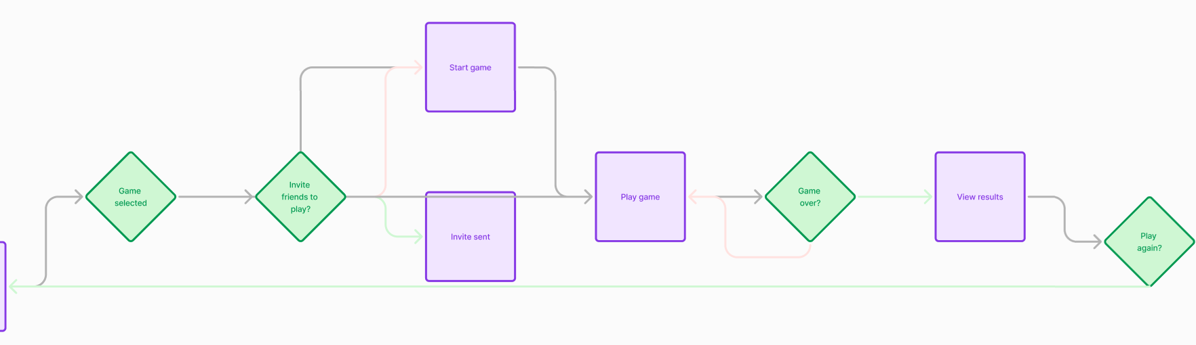
Workflow

Slide 17
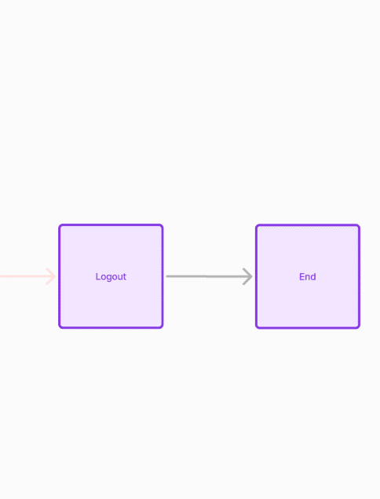
Workflow

Slide 18


Reports
Game Statistics Report: Provides an overview of player activity across all games, including total playtime, the number of games played, and the most popular games.
User Engagement Report: Shows user sign-up statistics, active users, and daily/monthly active user trends.
Leaderboard Report: Displays top-ranking players for each game along with their scores and playtime.
Game Performance Report: Analyzes individual game performance, including load times, user feedback, and average session duration.

Slide 19




References
1. Bellotti, F., Kapralos, B., Lee, K., Moreno-Ger, P., & Berta, R. (2010). *Assessment in and of serious games: An overview*. Advances in Human-Computer Interaction, 2010, 1-11. Doi:10.1155/2010/121132.
2. Nielsen, J. (2000). *Designing Web Usability: The Practice of Simplicity*. New Riders Publishing.
3. Evans, M. (2013). *HTML5 Game Development Insights*. Apress.
4. Werbach, K., & Hunter, D. (2012). *For the Win: How Game Thinking Can Revolutionize Your Business*. Wharton Digital Press.
5. Pollari, K. (2016). *Cyber Security in Online Gaming: Challenges and Approaches to Protecting User Data*. International Journal of Computer Science and Information Security, 14(7), 71-76.

Slide 20



THANK YOU

